Slide 1

OpenGL ES – Getting Started Chapter 1
Eng. Basma Hassan
Eng. Samar Shaban

Slide 2
What is OpenGL ES ??
OpenGL ES ( OpenGL for Embedded System )
A subset of the OpenGL application programming interface (API)
Used in a wide variety of devices, not just Android
iPad, iPhone, Blackberry, symbian, Playstation 3, Web GL
Lightweight interface
Required Android classes:
GLSurfaceView and GLSurfaceView.Renderer

Slide 3

OpenGL ES Versions
OpenGL ES 1.0 and 1.1
supported by Android 1.0 and higher.
OpenGL ES 2.0
supported by Android 2.2 (API level 8) and higher.
OpenGL ES 3.0
supported by Android 4.3 (API level 18) and higher.
OpenGL ES 3.1
supported by Android 5.0 (API level 21) and higher.
OpenGL ES 2.0
Froyo
Android 2.2.x

Slide 4
Steps to Use OpenGL ES
Create activity using GLSurfaceView and GLSurfaceView.Renderer
Create and draw graphics objects
Define projection for screen geometry
Define a camera view
Perform actions to animate objects
Make view touch interactive if desired

Slide 5
Emulator Configuration
Check the checkbox next to Use Host GPU (graphics processing unit).
Using an x86 Emulator:
download the Intel x86 Atom System Image
install the Intel Hardware Accelerated Execution Manager (HAXM)
ensure that ‘Intel Virtualization Technology (VT-x)’ is enabled in your BIOS system settings.

Slide 6
Creating Our First OpenGL Program

Slide 7
Simple OpenGL Program
This program will be very simple: all it will do is
initialize OpenGL , and
clear the screen continuously

Slide 8
Manifest Requirements
To use OpenGL ES 2.0, you must add the following declaration to your manifest:

Slide 9
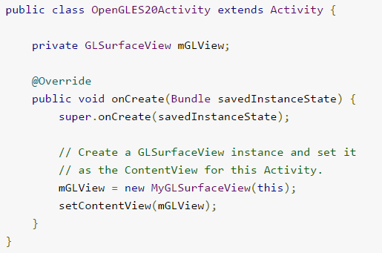
Activity

Slide 10
GLSurfaceView
A specialized view where you can draw OpenGL ES graphics.
The actual drawing of objects is controlled in the GLSurfaceView.Renderer.
Rendering is done on a special area of the display, called a surface (viewport)
Calls the renderer when the surface is created or changed, as well as when it’s time to draw a new frame.
Captures touch screen events.
Handles the standard Android activity life cycle.
The essential code for a GLSurfaceView is minimal.
Notes:
GLSurfaceView takes care of the grittier aspects of OpenGL initialization, such as configuring the display and rendering on a background thread. This rendering is done on a special area of the display, called a surface; this is also sometimes referred to as a viewport.
Renderer will be called by the GLSurfaceView when the surface is created or changed, as well as when it’s time to draw a new frame.

Slide 11
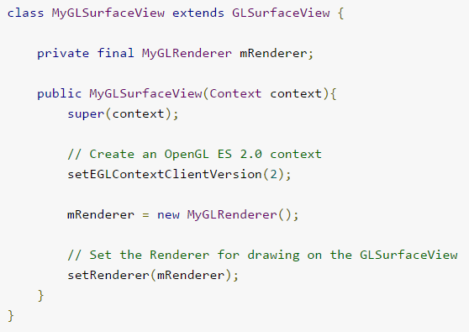
GLSurfaceView

Slide 12
Handling Android’s Activity Life Cycle Events
We still need to handle Android’s activity life cycle events; otherwise we’re going to crash if the user switches to another application.
OnPause()
OnResume()
Surface view can properly pause and resume the background rendering thread as well as release and renew the OpenGL context.

Slide 13
GLSurfaceView.Renderer
An interface which controls what gets drawn on the GLSurfaceView
Must implement these methods:
onSurfaceCreated() - GLSurfaceView calls this when the surface is created.
onSurfaceChanged() - GLSurfaceView calls this after the surface is created and whenever the size has changed (orientation).
onDrawFrame() - GLSurfaceView calls this when it’s time to draw a frame (redraw for movement and animation)

Slide 14
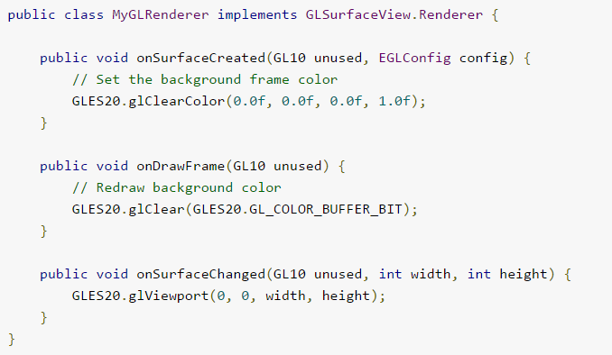
Renderer

Slide 15
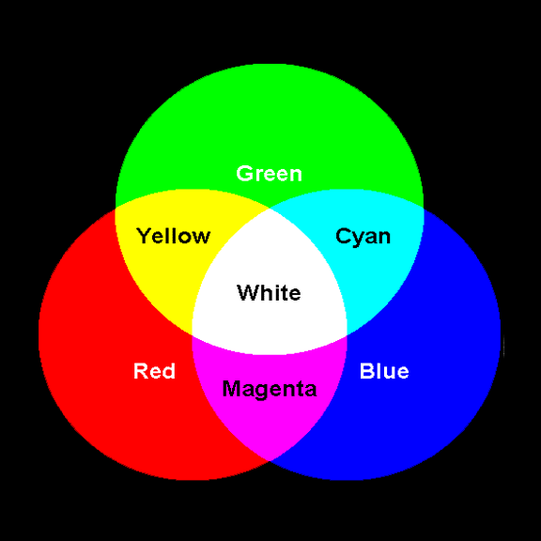
OpenGL Color Model
Additive RGB color model (red, green, and blue)
Many colors can be created by mixing these primary colors together in various proportions.
In OpenGL, colors are clamped to the range [0, 1].
0 → absence
1 → maximum strength

Slide 16
Hints and Notes
Useful Eclipse shortcuts:
Ctrl+Shift+O
used to organize and bring in new Java imports (all missing classes will be imported, and the unused imports will vanish).
Ctrl+Space
Opens Content Assist (e.g. show available methods or field names)
If emulator is not working for you:
Be sure that “Use Host GPU” is checked in the emulator settings,
Try adding a call to
setEGLConfigChooser(8, 8, 8, 8, 16, 0);
before the call to setRenderer() in GLSurfaceView class.

Slide 17
Additional Information
OpenGL ES
For more information:
http://www.khronos.org/opengles/
Android OpenGL ES lessons http://developer.android.com/training/graphics/opengl/index.html
Learn OpenGL ES http://www.learnopengles.com/

Slide 18

See you Next Lab

